Slide 1

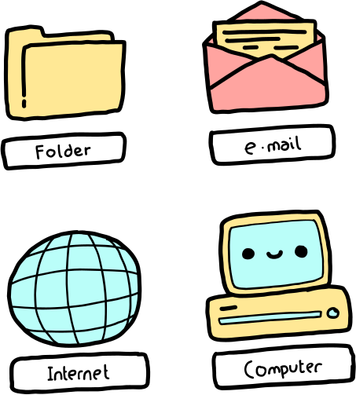

Prateek Kumar (IITRPR_24081244)
PROJ_SYNAPSE :
UNIFIED LEARNER PROFILING MODEL
OPEN

Slide 2




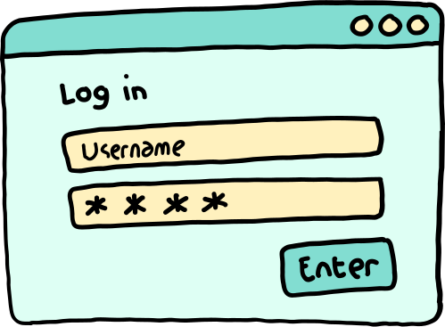
OVERVIEW
INTRODUCTION
STATEMENT OF THE PROBLEM
SIGNIFICANCE OF THE STUDY
METHODOLOGY
RESULTS FINDINGS
DISCUSSION
REFERENCES
Prateek Kumar
IITRPR_24081244

Slide 3

Introduction
Proj_Synapse is a novel, unified framework that integrates a sophisticated ensemble of five deep learning architectures to predict student success.
It utilizes sequential learning interaction data to generate predictions.
The framework is enriched by integrating established educational and psychological frameworks: the Myers-Briggs Type Indicator (MBTI), the VARK learning styles model, and Bloom's Taxonomy.
The goal is to move beyond simple success/failure predictions to provide students with specific,

Slide 4
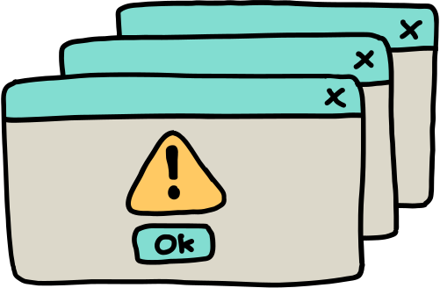
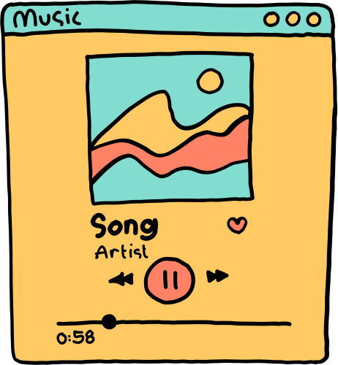
Statement of the Problem
Difficulty in translating raw student data into actionable, personalized insights.
Existing models struggle with predictive accuracy and interpretability (the "black box" problem).
Identifying "at-risk" students is insufficient without understanding
why and how to intervene.

Slide 5
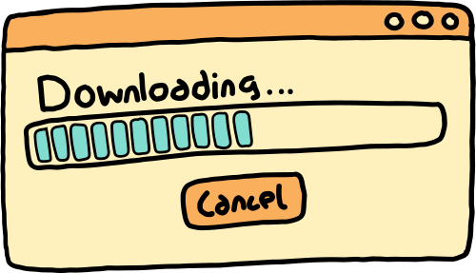
Demonstrates a powerful hybrid approach combining deep learning with educational theory.
Introduces a novel method to enrich data with learner profiles (MBTI, VARK).
Creates a system that converts predictions into specific, educationally sound recommendations.
Significance of the Study

Slide 6

Methodology
Data: Analyzed over 9,000 learning session records from 300 students.
Model: Employed a soft voting ensemble of five deep learning architectures (BiLSTM, CNN-GRU, Transformer, etc.).
Augmentation: Enriched data by simulating MBTI, VARK, and Bloom's level profiles.
Feedback Engine: Used a rule-based system to generate personalized feedback based on student profiles.
Evaluation: Measured performance using the F1-Score, precision, and recall.

Slide 7

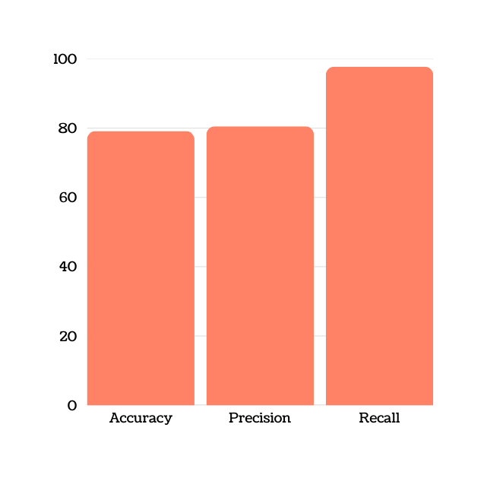
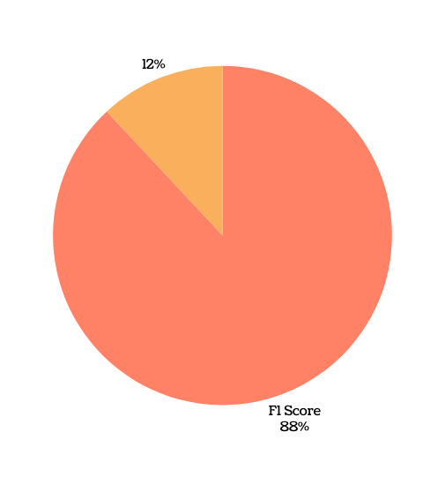
Results
Unified Ensemble Model achieved a superior F1-Score of 0.8831.
Accuracy: 79.13%, Precision: 80.52%, and an exceptional Recall: 97.77%.

Slide 8
Findings
The ensemble approach is demonstrably more effective than using individual deep learning models for predicting student success.
Performance metrics like assignment_score and quiz_score were the most significant predictors of success.
Engagement metrics, particularly time_spent_minutes, were also highly important in predicting outcomes.
Error analysis revealed that the model struggled most with sequences that had inconsistent or ambiguous learning patterns.

Slide 9
Discussion
Proj_Synapse successfully bridges the gap between raw predictive analytics and actionable educational strategies.
By incorporating holistic frameworks (MBTI, VARK, Bloom's), the system moves from being a simple predictor to a diagnostic tool.
The high recall rate (97.77%) is a significant achievement, ensuring that the vast majority of struggling students are correctly identified.
The system can provide highly specific feedback, such as advising a "Visual" learner struggling with an "Analyzing" task to "review the concept map to see how the pieces are connected".
Ethical considerations are important, including data privacy, algorithmic bias, and the danger of student stereotyping. Methodological limitations include the use of simulated profiles and the need for broader generalizability

Slide 10
References
Baker, R. S. J. d., Yacef, K. (2009). The state of educational data mining in 2009.
Journal of Educational Data Mining, 1(1), 3-17.
Fleming, N. D., Mills, C. (1992). Not another inventory, rather a catalyst for reflection.
To Improve the Academy, 11(1), 137-155.
Myers, I. B., Myers, P. B. (1980). Gifts differing. Davies-Black Publishing.
Piech, C., et al. (2015). Deep knowledge tracing.
Advances in Neural Information Processing Systems, 28.
VanLehn, K. (1988). Student modeling. In Foundations of intelligent tutoring systems (pp. 55-78).
Vaswani, A., et al. (2017). Attention is all you need. Advances in Neural Information Processing Systems, 30.

